Slide 1
2023-01-18

Slide 2
7.6.2
Insertion Sort

Slide 3
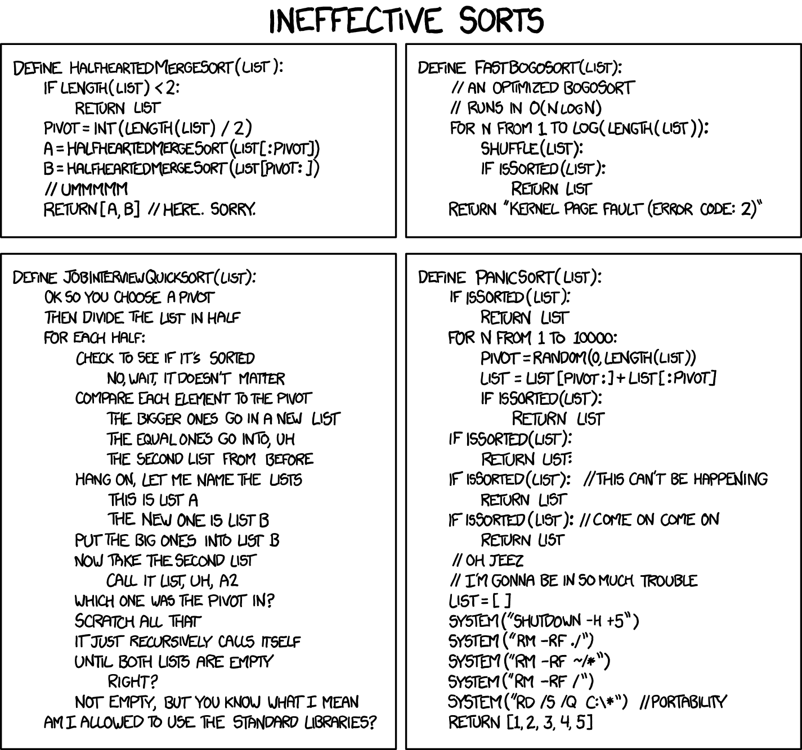
https://xkcd.com/1185/

Slide 4
Preconditions, Postconditions, and Invariants
We learned about these already:
A precondition to a method must be true before entering the method.
A postcondition to a method must be true when leaving the method.
An invariant is some condition that must always be true.
Example: In the class StudentDirectory, the data in the ArrayList "students" is always in sorted order by name.
Preconditions, postconditions, and invariants are used to formally prove the correctness of algorithms.

Slide 5
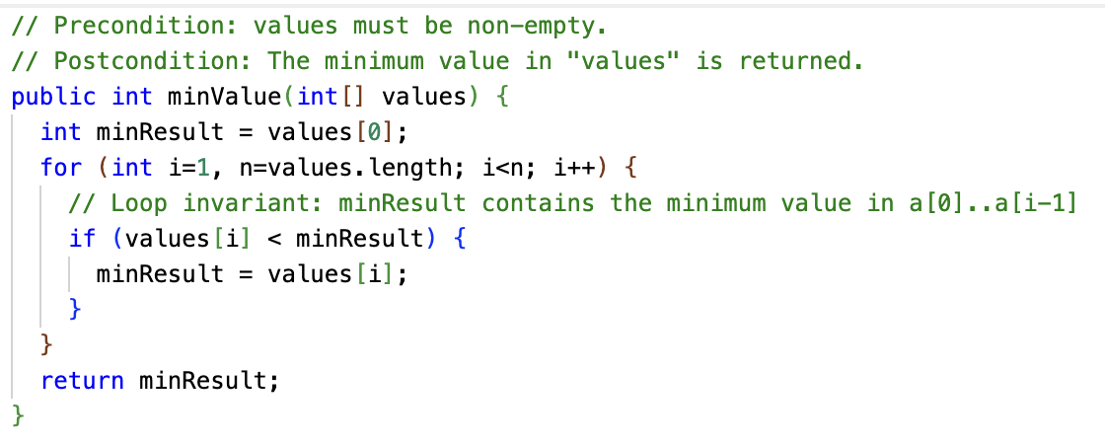
Loop Invariants
A loop invariant is a condition that must be true at the beginning and end of the body of a loop. (It might not be true while the loop body is doing its work, like swaps.)

Slide 6
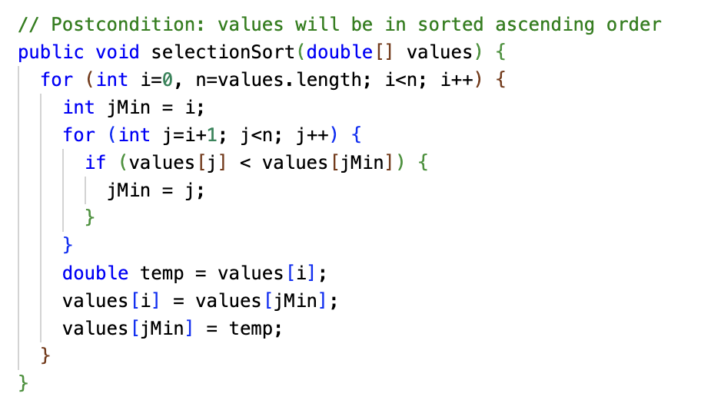
What's the loop invariant in Selection Sort?

Slide 7
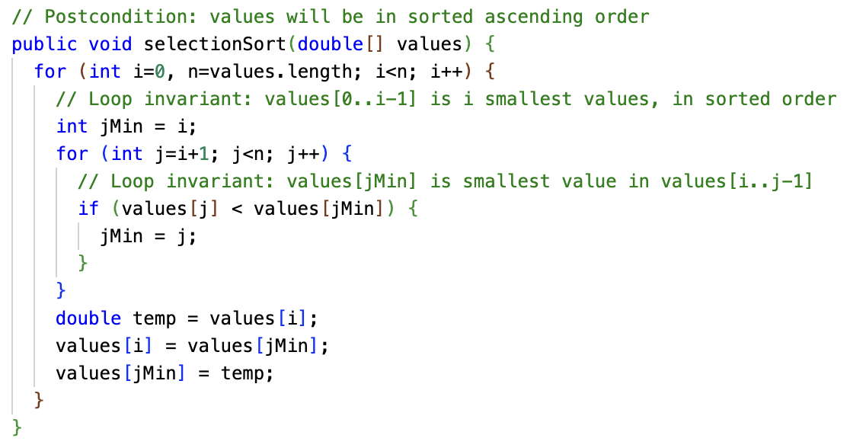
Trick question: There were two loop invariants

Slide 8
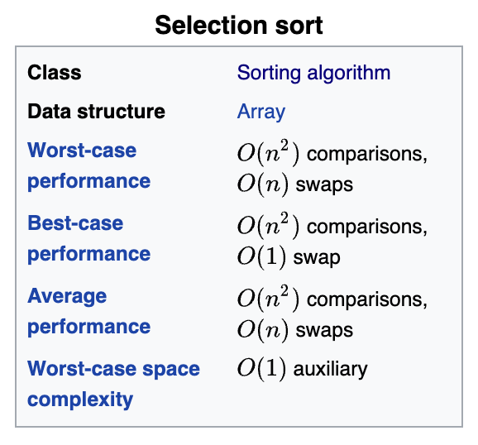
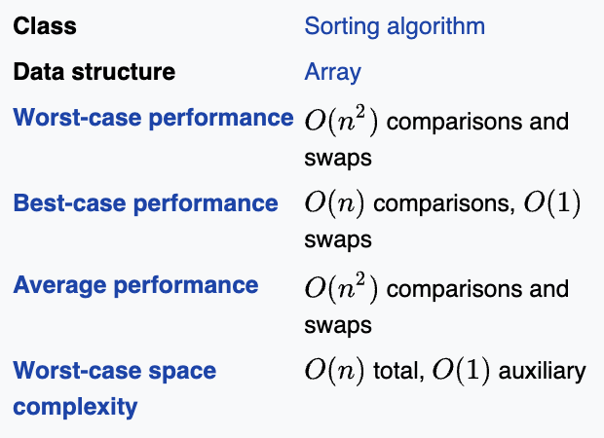
Introducing Insertion Sort
Insertion Sort is more complex than Selection Sort, but is much faster when the data is partially sorted. Unfortunately, it is still a quadratic algorithm, that is, O(N²).
Insertion Sort

Slide 9
Insertion Sort Algorithm
Insertion Sort has a loop invariant that for index i, the entire sub-array to the left of i is in sorted order.
This is slightly different from Selection Sort's loop invariant... how?
Insertion Sort's outer loop starts with i = 1, that is, pointing to the second element in the array.
Why? The sub-array to the left of i = 1, a[0..0], is in sorted order, because a one-element array is always in sorted order!

Slide 10
Insertion Sort Algorithm
// Note we start with second element i = 1 for i ← 1 to length(array) // Loop invariant: The array to the left of i is a sorted sub-array. // j will represent the insertion point of the value. j ← i while j > 0 and A[j-1] > A[j] // As we scan for insertion point, we swap the element // we are inserting (which will move to the left) with the // element to its left. swap A[j], A[j-1] j ← j - 1 end while end for

Slide 11
Insertion Sort Algorithm: Swapless Edition
// A bit more efficient than swapping. Less read/write operations. // Note we start with second element i = 1 for i ← 1 to length(array) // Loop invariant: The array to the left of i is a sorted sub-array. // Save the value at A[i], as it may be overwritten x ← A[i] // j will represent the insertion point of the value. j ← i while j > 0 and A[j-1] > x // As we scan for insertion point, we move elements // to the right. A[j] ← A[j-1] j ← j - 1 end while // Finally, write the element being inserted into its final spot. A[j] ← x end for

Slide 12
Insertion Sort
Let's work through an Insertion Sort. We'll start with this unsorted array.
(We're going to work through the "swapless edition" where we save the element under consideration in a variable x, and copy elements to the right, as opposed to the "swapping" edition which swaps the element to insert repeatedly to the left.)
9
13
6
7
1
16
3
12

Slide 13
Insertion Sort
i = 1 (the second element)
Current value to insert is 13. Scan left for insertion point, i.e. j such that A[j] > A[i]
9
13
6
7
1
16
3
12
As we scan, we move elements one slot to the right. The scan ends when insertion point is found.
9
13
6
7
1
16
3
12
Since 13 > 9, the scan stops immediately and no change is made. The insertion point was 1.

Slide 14
Insertion Sort
i = 2
Scan left for insertion point for 6, moving elements one to the right as we go.
9
13
6
7
1
16
3
12
13 > 6 and 9 > 6, so 13 and 9 move one slot to the right, and 6 is inserted at slot 0.
6
9
13
7
1
16
3
12

Slide 15
Insertion Sort
i = 3
Scan left for insertion point for 7. 13 > 7 and 9 > 7, but 6 < 7, so scan stops at index 1.
6
9
13
7
1
16
3
12
As the scan proceeded, it moved 13 and 9 to the right, making room for 7.
6
7
9
13
1
16
3
12

Slide 16
Insertion Sort
i = 4
Find insertion point for 1. 13 > 1, 9 > 1, 7 > 1, 6 > 1, so we scan all the way to index 0.
6
7
9
13
1
16
3
12
The 1 is written to slot 0, and 6, 7, 9, and 13 have been moved to the right.
1
6
7
9
13
16
3
12

Slide 17
Insertion Sort
i = 5
Find where 16 should be inserted. 16 > 13, so the scan stops immediately.
1
6
7
9
13
16
3
12
When the scan stops immediately, it means the insertion point is where the element already is.
1
6
7
9
13
16
3
12

Slide 18
Insertion Sort
i = 6
Find insertion point for 3. We scan past 16, 13, 9, 7, and 6, but stop at 1 because 1 < 3.
1
6
7
9
13
16
3
12
During the scan, 16, 13, 9, 7, and 6 moved to the right, making room for 3.
1
3
6
7
9
13
16
12

Slide 19
Insertion Sort
i = 7
Find insertion point for 12. 16 > 12 and 13 > 12, so we move 16 and 13 to the right.
1
3
6
7
9
13
16
12
12 > 9, so the scan stops and the 12 is written at slot 5.
1
3
6
7
9
12
13
16
Aaaaand... Done.

Slide 20
Insertion Sort
What input array would result in the best case running time?
What input array would result in the worst case running time?
Compare to Selection Sort's best and worst case running time.

Slide 21
Insertion Sort: Average Case
The average case takes some math to calculate, but works out to O(N²).
However, it works out to half the comparisons, on average, that Selection Sort does.
Selection Sort always does the same number of comparisons, but varies in number of swaps.
Insertion Sort can do as many comparisons as Selection Sort, but does about half the comparisons on a random input array.
So, not all O(N²) are alike... the running time is bounded by N², but different O(N²) algorithms behave differently, sometimes much better or worse.

Slide 22
Insertion Sort: Is it good? Do people actually use it?
Insertion Sort is faster in practice than other quadratic algorithms such as Selection Sort or Bubble Sort.
Insertion Sort is actually one of the fastest known algorithms for sorting very small arrays. (Around <=10 items.)
Quicksort is the common "fast" algorithm used in many standard libraries for any size input, but sometimes the sort method will switch to Insertion Sort for very small inputs.

Slide 23
Exercise: Build your own Insertion Sort
Repl.it: InsertionSort
This is similar to the SelectionSort exercise. We'll use the Fortune 500 data set again.
You will be sorting not just by company name, but by all of the other fields! Look at the getField() method in Record.java.
You will be sorting in ascending and descending order.
Your Insertion Sort shouldn't use any ArrayList magic like add(obj, index)... so the code uses plain arrays, not ArrayList, to be sure.
Last week, we had to pay attention to case sensitivity. This time, we need to do that as well, but we also need to flip the comparison when sorting in descending order. How would you "reverse" the output of String.compareTo?

Slide 24
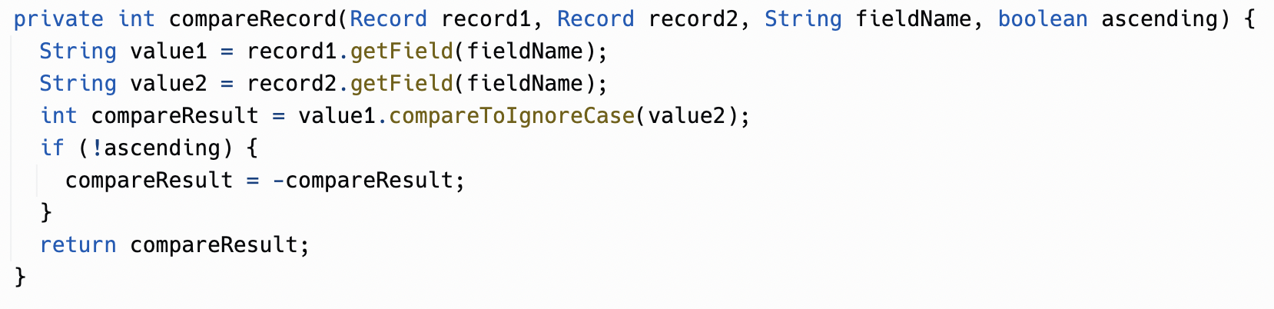

Slide 25
